Slide 1
Efficient Binary Trees

Slide 2
Binary Search Trees
A binary search tree (BST), also known as an ordered binary tree, is a variant of binary tree in which the nodes are arranged in order.
In a BST, all nodes in the left sub-tree have a value less than that of the root node.
Correspondingly, all nodes in the right sub-tree have a value either equal to or greater than the root node.
The same rule is applicable to every sub-tree in the tree.
Due to its efficiency in searching elements, BSTs are widely used in dictionary problems where the code always inserts and searches the elements that are indexed by some key value.

Slide 3
Binary Search Tree
39
27
45
18
29
40
54
9
21
28
36
59
10
19
65
60

Slide 4
AVL Trees
AVL tree is named after its inventors G M Adelson, Velsky and E M Landis in 1962.
AVL tree is a self-balancing binary search tree in which the heights of the two sub-trees of a node may differ by at most one. Because of this property, AVL tree is also known as a height-balanced tree.
The advantage of using an AVL tree is that it takes O(log n) time to perform search, insertion and deletion operations in average case as well as worst case i.e O(log n).
The structure of an AVL tree is same as that of a binary search tree but with a little difference. In its structure, it stores an additional variable called the BalanceFactor.

Slide 5
AVL Trees
The balance factor of a node is calculated by subtracting the height of its right sub-tree from the height of its left sub-tree.
Balance factor = Height (left sub-tree) – Height (right sub-tree)
A binary search tree in which every node has a balance factor of -1, 0 or 1 is said to be height balanced. A node with any other balance factor is considered to be unbalanced and requires rebalancing.
If the balance factor of a node is 1, then it means that the left sub-tree of the tree is one level higher than that of the right sub-tree. Such a tree is called Left-heavy tree.
If the balance factor of a node is 0, then it means that the height of the left sub-tree is equal to the height of its right sub-tree.
If the balance factor of a node is -1, then it means that the left sub-tree of the tree is one level lower than that of the right sub-tree. Such a tree is called Right-heavy tree.

Slide 6
AVL Trees
Left heavy AVL tree
Balanced AVL tree
45
1
0
1
0
45
36
63
0
0
1
36
63
27
0
0
0
54
72
39
0
0
0
0
0
18
27
39
54
72
Right heavy AVL tree
-1
45
0
-1
36
63
0
27
0
0
1
39
54
72
70
0

Slide 7
Searching for a Node in an AVL Tree
Searching in an AVL tree is performed exactly the same way as it is performed in a binary search tree.
Because of the height-balancing of the tree, the search operation takes O(log n) time to complete.
Since the operation does not modify the structure of the tree, no special provisions need to be taken.

Slide 8
Inserting a Node in an AVL Tree
Since an AVL tree is also a variant of binary search tree, insertion is also done in the same way as it is done in case of a binary search tree.
Like in binary search tree, the new node is always inserted as the leaf node. But the step of insertion is usually followed by an additional step of rotation.
Rotation is done to restore the balance of the tree. However, if insertion of the new node does not disturb the balance factor, that is, if the balance factor of every node is still -1, 0 or 1, then rotations are not needed.

Slide 9
Inserting a Node in an AVL Tree
During insertion, the new node is inserted as the leaf node, so it will always have balance factor equal to zero.
The nodes whose balance factors will change are those which lie on the path between the root of the tree and the newly inserted node.
The possible changes which may take place in any node on the path are as follows:
  Initially the node was either left or right heavy and after insertion has become balanced.
  Initially the node was balanced and after insertion has become either left or right heavy.
  Initially the node was heavy (either left or right) and the new node has been inserted in the heavy sub-tree thereby creating an unbalanced sub-tree. Such a node is said to be a critical node.

Slide 10
Rotations to Balance AVL Trees
To perform rotation, our first work is to find the critical node. Critical node is the nearest ancestor node on the path from the root to the inserted node whose balance factor is neither -1, 0 nor 1.
The second task is to determine which type of rotation has to be done.
There are four types of rebalancing rotations and their application depends on the position of the inserted node with reference to the critical node.
LL rotation: the new node is inserted in the left sub-tree of the left sub-tree of the critical node
RR rotation: the new node is inserted in the right sub-tree of the right sub-tree of the critical node
LR rotation: the new node is inserted in the right sub-tree of the left sub-tree of the critical node
RL rotation: the new node is inserted in the left sub-tree of the right sub-tree of the critical node

Slide 11
LL & RR rotations are called single rotations
LR & RL rotations are called double rotations
LR Rotation includes 2 steps
Perform RR on child subtree
Perform LL on the entire tree
RL Rotation includes 2 steps
Perform LL on child subtree
Perform RR on the entire tree

Slide 12
LL Rotation
Let the grandparent (critical code) be represented as gp. Its child is parent (par) and its child is represented as ch in the path of the inserted node to root.
[h is the height of the subtrees T1, T2,T3,T4]
(h+2 - h)
2
gp
L
0
par
1
par
T_{4 (h)}
LL
L
T_{3 (h)}
0
0
0
ch
ch
gp
T_{1 (h)}
T_{2 (h)}
T_{1 (h)}
T_{2 (h)}
T_{3 (h)}
T_{4 (h)}
LL Rotation tilt the tree towards right

Slide 13
Example: Insert 20 into the AVL tree
1
50
1
0
40
70
0
30
After insertion the tree is
2
The critical node (gp) is 40 par is 30 and ch=20. Perform LL rotation
50
2
0
40
70
1
30
0
20

Slide 14
The final AVL tree after LL Rotation is
1
50
0
0
(The tree is Avl balanced)
30
70
0
0
20
40
Similarly
RR Rotation
-2
0
gp
par
R
RR
0
T_{1 (h)}
-1
0
T_{1 (h)}
par
ch
gp
R
T_{2 (h)}
ch
0
T_{1 (h)}
T_{2 (h)}
T_{3 (h)}
T_{4 (h)}
T _{3 (h)}
T_{4 (h)}

Slide 15
LR Rotation
LR Rotation
2
gp
0
L
ch
LR
-1
T_{4 (h)}
par
0
0
R
gp
par
0
T_{1 (h)}
ch
T _{1 (h)}
T _{2 (h)}
T _{3 (h)}
T _{4 (h)}
T_{2 (h)}
T _{3 (h)}
Consider ch moving in between par and gp on top. Therefore par is left and gp is right child.
LR rotation includes 2 steps
Perform RR on child subtree
Perform LL on entire tree

Slide 16
a
b
2
gp
gp
L
-1
par
T ₄(h)
ch
T ₄
RR on child subtree
R
L
ch
0
LL
T _{1(h)}
par
T ₃
R
in RR on child subtree
T _{2 (h)}
T _{3 (h)}
T ₁
T ₂
gp=par
Par=ch
Ch=T3
Perform LL on
b
ch
par
gp
T ₁
T ₂
T ₃
T ₄

Slide 17
RL Rotation
RL Rotation
-2
gp
0
R
ch
par
1
T _{1 (h)}
RL
0
0
0
L
gp
par
ch
T_{4 (h)}
T _{2 (h)}
T ₃ (h)
T _{1 (h)}
T _{2 (h)}
T _{3 (h)}
T _{4 (h)}
RL includes performing LL on child subtree & RR on entire tree

Slide 18
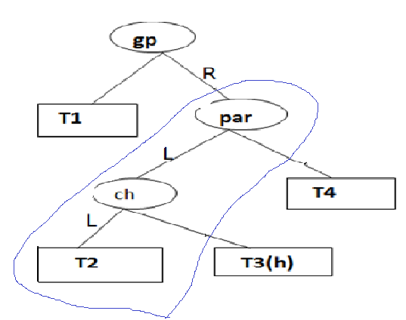
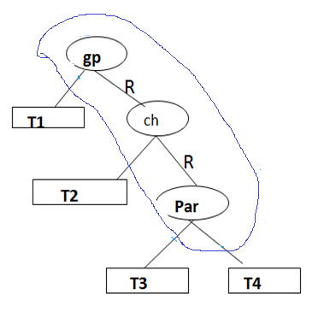
LL
ch
RR
gp
par
T1
T2
T3
T4

Slide 19
Example: Perform LR rotation by inserting 37
1
45
0
0
Insert 37
2
36
45
63
Imbalance at 45
-1
0
∴ gp=45
par=36
ch=39
Now Perform LR
0
0
36
63
27
39
0
1
27
39
37
0

Slide 20
0
39
LR
0
-1
36
45
0
0
0
27
37
63
Example: Perform RL by inserting 85 into the tree
-2
60
-1
Insert 85
60
0
-2
30
80
0
1
R
30
80
1
90
0
90
L
85
0

Slide 21
gp=80
par=90
ch=85
-1
60
Perform RL
0
0
Resultant tree is AVL Tree
30
85
0
0
80
90

Slide 22
Example: Construct AVL tree with values 30,35,38, 20, 10, 25, 22, 28, 24, 29, 40, 50
Solution
insert 35
-1
insert 38
Insert 20
1
Insert 30
0
-2
RR
0
30
30
30
35
R
35
1
0
0
-1
0
35
35
0
30
38
30
38
R
0
0
38
20
2
35
Insert 10
2
0
LL
1
30
38
35
L
0
0
20
38
20
L
0
0
10
30
10

Slide 23
insert 25
2
0
35
30
0
0
LR
20
38
0
-1
insert 22
20
35
0
1
10
30
0
1
0
10
25
38
25
0
1
30
1
30
-1
-1
insert 28
20
35
-1
-1
20
35
0
1
0
10
25
38
0
0
38
10
25
0
0
22
0
22
28
0

Slide 24
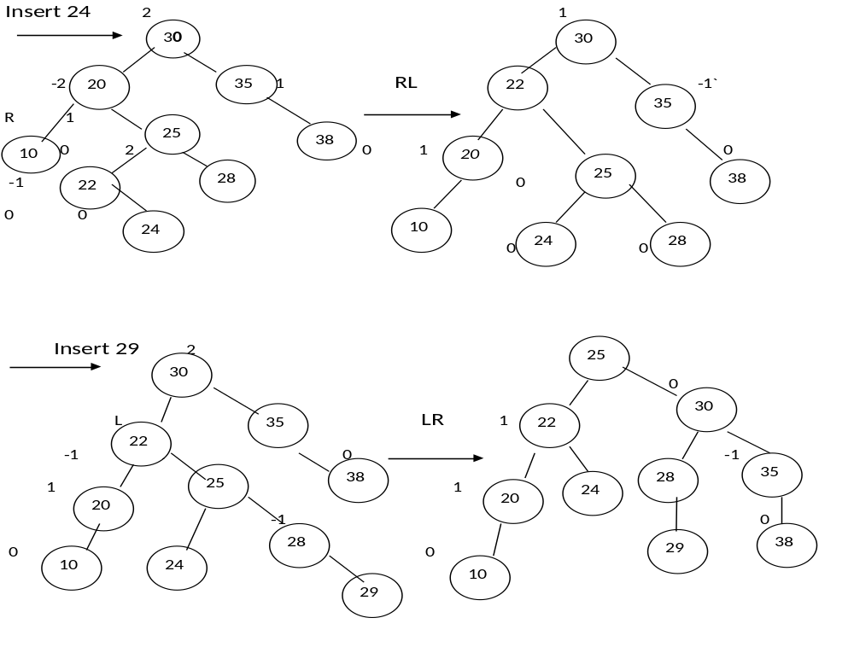

Slide 25
0
-1
25
Insert 40
25
0
-1
1
30
RR
22
1
30
22
-2
1
0
35
20
24
28
38
0
-1
1
24
R
0
0
20
-1
0
28
-1
38
R
10
29
35
40
0
0
0
0
0
10
29
40
-1
25
RR
25
-1
30
Insert(50)
1
30
22
22
-1
-1
38
1
38
20
0
28
-1
20
24
24
40
0
40
0
29
0
10
29
10
35
0
35
50
50

Slide 26
Deleting a Node from an AVL tree
Deleting a Node from an AVL Tree
Delete a node from an AVL tree follows the same process as deleting a node from a Binary search tree.
After deletion , the resultant AVL tree may not be an AVL tree as there is an imbalance .do rebalance , we need to perform rotations .There are 2rotations
→Left (L) rotation and
Right (R) rotation .
There are 3 categories of L & R Rotation .
L-1,L0,L1 and R-1,R0 & R1.
R0 ,R1 → is like LL rotation
R-1 → LR rotation
L0 ,L-1 → is like RR rotation
L1 → RL rotation

Slide 27
RO Rotation
After deleting the Element , the closest ancestor from the deleted node toward
the root with imbalance is the critical node. Let A be the critical node.
If the deleted node is in the right subtree of the critical node A ,R rotation must be applied consider the root of the left subtree of A let it be B. consider the balance factor (bf) of B.
If bf(B) = 0 → Perform RO rotation
If bf(B) =1 → Perform R1 rotation
If bf(B) =-1 → Perform R-1 rotation

Slide 28
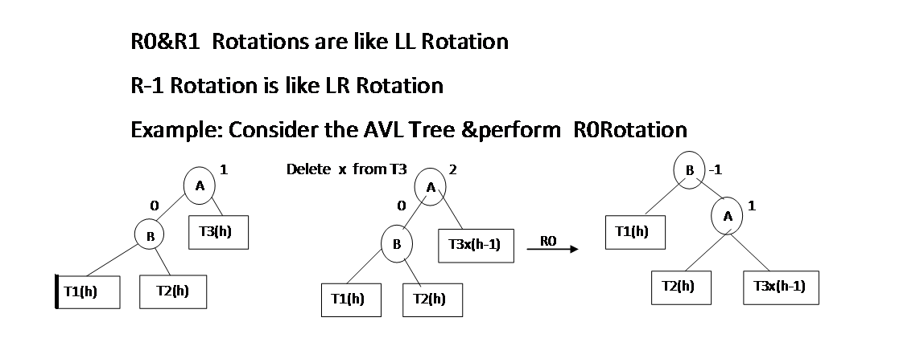

Slide 29
Example: Delete 72 from the AVL tree
1
2
45
45
1
1
0
-1
36
63
36
63
Delete 72
1
0
0
0
1
72
27
39
27
39
0
18
0
18
0
36
0
R1
1
45
27
0
0
39
0
63
18

Slide 30
R1 Rotation
2
A
B
0
A
1
Delete x from T3
R1
A
0
1
B
T3(h-1)
1
B
T3_{X}(h-1)
T1(h)
T1(h)
T2(h-1)
T1(h)
T2(h-1)
T2(h-1)
T3(h-1)
Delete 72 from AVL Tree
2
R1
0
1
45
36
45
Delete 72
1
36
63
1
0
-1
0
45
1
27
36
63
1
27
39
0
1
0
18
27
39
0
0
0
39
63
72
0
18
0
0
18
© Oxford University Press 2013. All rights reserved.

Slide 31
R-L Rotation
A
1
A
2
Delete x from T4
-1
R-1 Rotation
-1
B
T4(h)
B
T4(h-1)
T1(h-1)
C
C
0
T1(h-1)
T2(h-1)
T3(h-1)
T2(h-1)
T3(h-1)
R-L Rotation is LR Rotation
0
C
0
B
A
0
T1(h-1)
T2(h-1)
T3(h-1)
T4(h-1)

Slide 32
Example
delete 72 from the AVL Tree
2
0
1
45
39
45
Delete 72
LR
1
-1
36
63
0
36
63
-1
0
36
45
0
1
27
39
1
0
27
39
72
0
0
0
1
27
37
41
0
63
0
37
41
37
41
0
1
1
© Oxford University Press 2013. All rights reserved.

Slide 33
Red Black Trees
A red-black tree is a self-balancing binary search tree.
Although a red black tree is complex, it has good worst-case running time for its operations and is efficient to use as searching, insertion, and deletion can all be done in O(log n) time, where n is the number of nodes in the tree.
A red-black tree is a binary search tree in which every node has a color which is either red or black. Apart from the other restrictions of binary search trees, red black trees have some additional properties
  RB1: The root node and the external nodes are always black nodes.
  RB2: [Red Condition] No two red nodes can occur consecutively on the path from the root node to an external node.
  RB3: [Black Condition] The number of black nodes on the path from the root node to an external node must be the same for all external nodes.

Slide 34
Red Black Trees
16
9
27
7
11
21
45
NULL
11
NULL
NULL
NULL
NULL
36
63
NULL
NULL
NULL
NULL
NULL
NULL
These constraints enforce a critical property of red-black trees, that is, the longest path from the root node to any leaf node is no more than twice as long as the shortest path from the root to any other leaf in that tree.
Operations such as insertion, deletion, and searching has worst-case time proportional to the height of the tree.
Searching a Red-Black Tree
It is same as searching for an element in BST.

Slide 35
Change color of x and g
Black
uncle
red
Apply rotation
Change color of p, g, u
Single LL_{b}, RR_{b}
double RL_{b,} LR_{b}
Change color of p, g
Change color of x & g
Pointers to black nodes are thick pointers
Pointers to red nodes are thin
© Oxford University Press 2013. All rights reserved.

Slide 36
Inserting a Node in a Red Black Tree
When a new node is inserted, it has to be assigned a color.
If the tree was empty before, this new node will be the root and hence should be assigned black.
Otherwise, if the tree is not empty before, if we assign the node black, it definitely violates the black condition.
If the new node is assigned red, it may or may not violate the red condition. Hence, it is better to assign red color to the new node.
Once the new node is added, the red property of the red-black tree may get violated and if it is violated, it is imbalanced.
Depending on the position of the node inserted and the color of “uncle” node , Imbalances are classified into 2 Categories
Category 1 : LLr, RRr, LRr, RLr
Category 2 : LLb, RRb, LRb, RLb

Slide 37
Inserting a Node in a Red Black Tree
Let the node inserted be x, the parent of x is “p” and parent of p is grand parent represented as “g”. Let uncle “u” be the sibling of parent p.
If the color of uncle u is red, depending on the position of x, LLr,RRr, LRr, RLr imbalances(Category 1) are performed and if the color of uncle is black, the LLb,RRb, LRb, RLb (Category 2).
For Category 1 imbalances (LLr,RRr, LRr, RLr imbalances) ---
Perform only Color Changes. Change color of p, g, u.
For Category 2 imbalances (LLb,RRb, LRb, RLb imbalances) ---
Perform rotation and then perform Color Changes.
For LLb, RRb -- Change color of p, g.
For LRb, RLb -- Change color of x, g

Slide 38
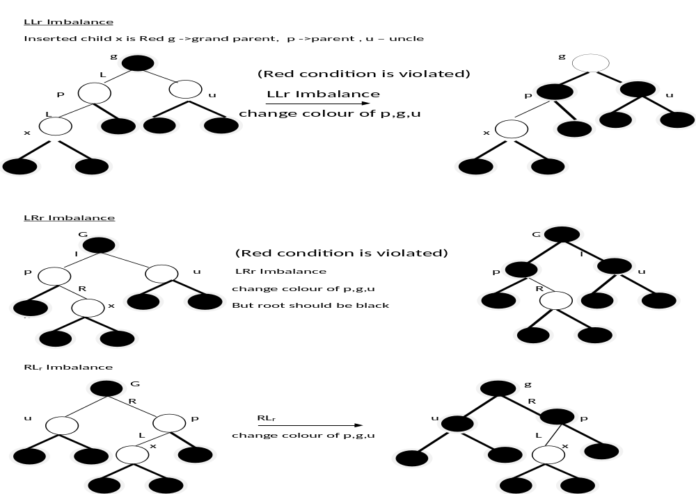

Slide 39
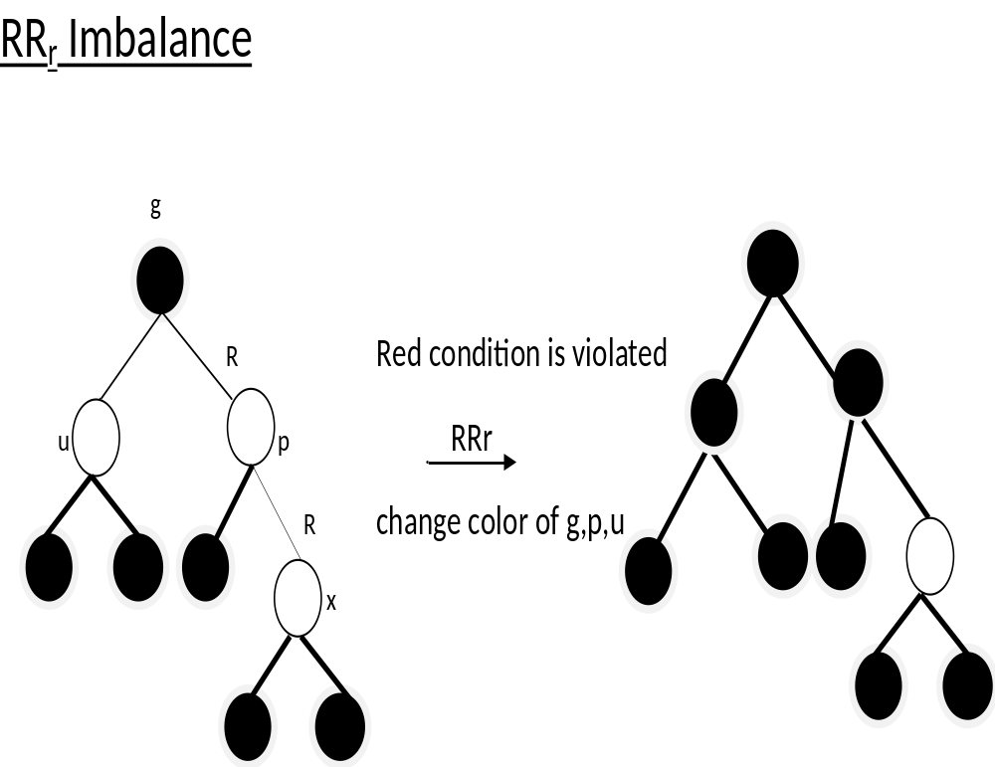

Slide 40
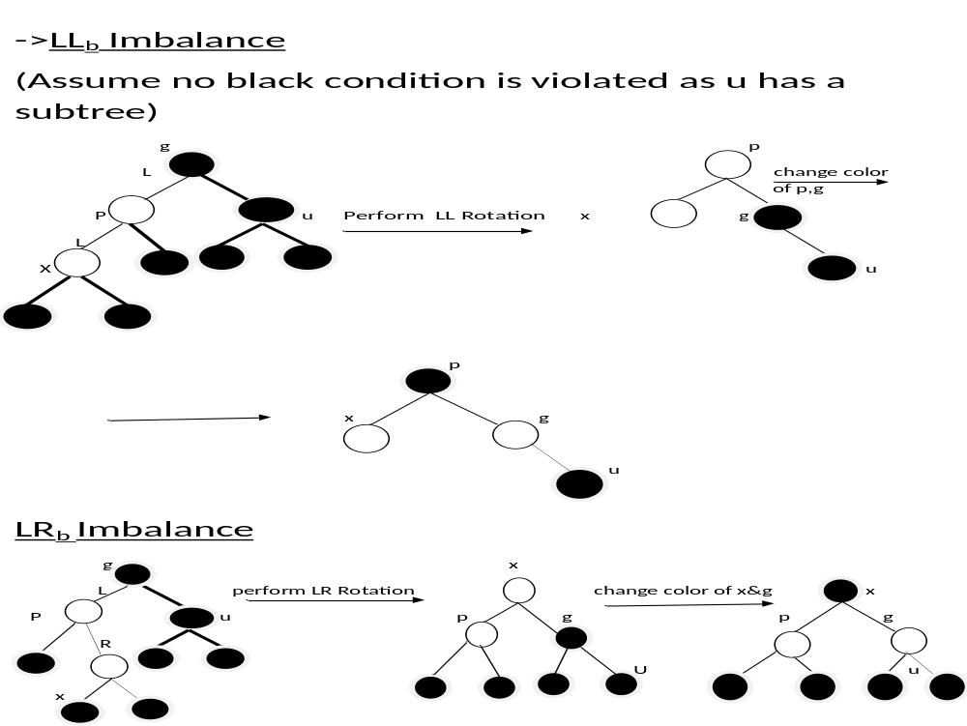

Slide 41
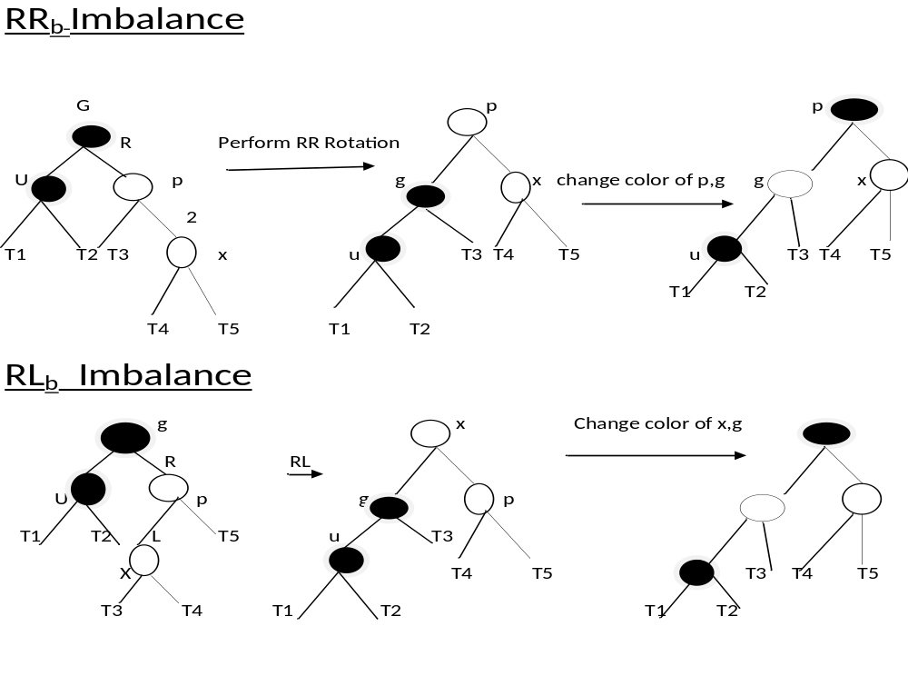

Slide 42
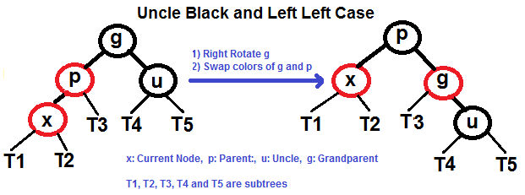

Slide 43
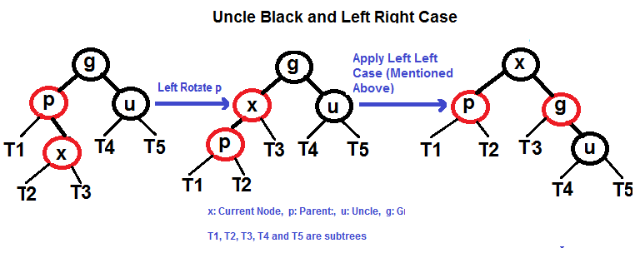

Slide 44
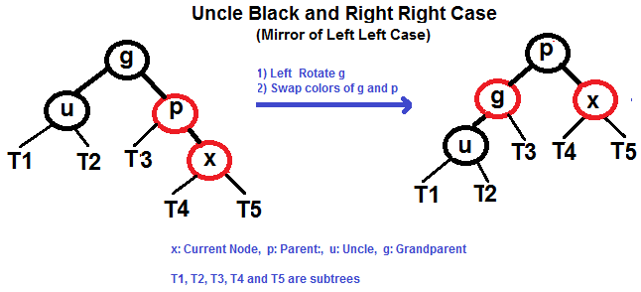

Slide 45
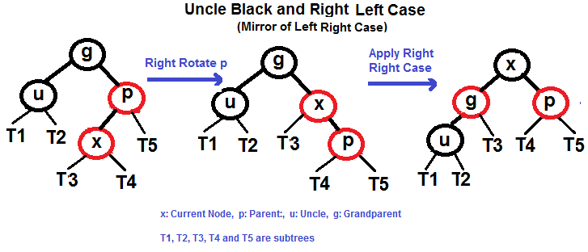

Slide 46
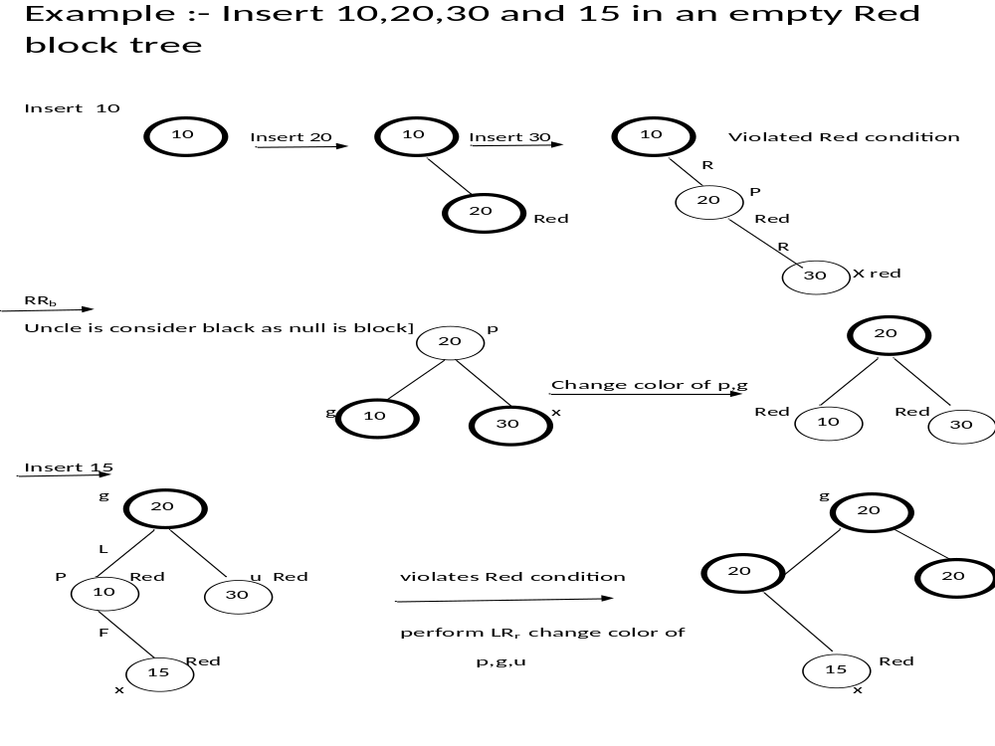

Slide 47
Example: Insert 14 into the red black tree
19
19
13
20
13
20
Insert 14
12
g
16
L
23
u
12
16
23
p
15
17
15
17
L
x
14
Red condition is violated perform LL_{R} is change color of g ,p, u . The resultant AVL tree is
g
Red condition is violated as 13 & 16 .g=19 , p=13, and x=16
19
L
u
circle is black LR_{b} how to be performed is Perform LR rotation and change the color of x ,g .
p
13
20
16
12
x
16
23
13
17
15
17
12
15
20
17
14
14
23

Slide 48
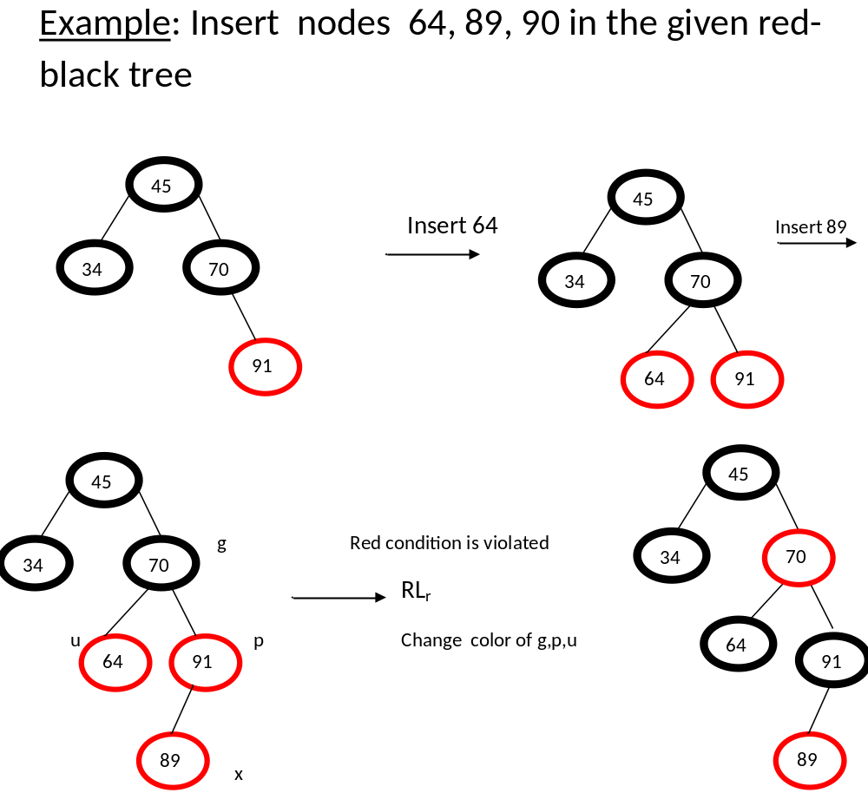

Slide 49

45
45
70
Red condition violated perform LR_{b}
34
34
70
64
91
Perform rotation and change colours of x, g
64
90
89
89
91
90
Example: Insert node 18 in the given red-black tree
37
12
55
12
55
p
2
24
60
2
24
60
g
30
20
30
20
x
L
18

Slide 50
Deletion from Red-Black Tree
Case | Parent | Sibling |  | Sibling Left Child | Sibling Right Child | Rotation | Color Change | Double Black Node
1 | N is root |  |  |  |  | - | Make N a single black Node | -
2 | B |  | R | B | B | If S is left child --- Apply LL at P If S is right child --- Apply RR at P | Change the color of P and S | N
3 | B |  | B | B | B | - | Change color of S to Red | P
4 | R |  | B | B | B | - | Change the color of P and S | -
5 | B |  | B | R | B | Apply LL at S | Change the color of S and x | N
6 | A |  | B | A | R | If S is left child --- Apply LL at P | Change the color of x and P to black. S color is P previous color | -
 |  |  |  |  |  | If S is right child --- Apply RR at P | Change the color of y and P to black. S color is P previous color
B- Black , R – Red, A – Either Black or Red, P – Parent, S- Sibling, x – S left child, y – S right child,

